Slide 1
PRESENTATION ON AZURE FUNCTIONS BY: Abhishek jain (DevOps engineer)

Slide 2
What is Azure Function?
Azure Function is a serverless compute service that enables user to run event-triggered code without having to provision or manage infrastructure. Being as a trigger-based service, it runs a script or piece of code in response to a variety of events.

Slide 3
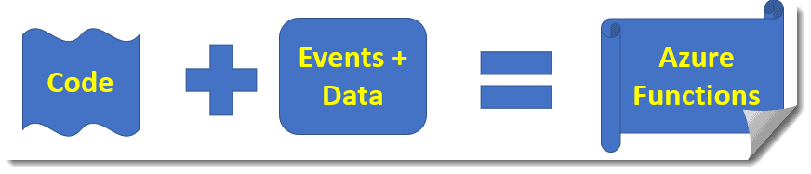
How Do Azure Functions Work

Slide 4
Features of Azure Functions
Multiple Language Support.
Serverless applications support.
Pay as you use pricing model.
Easy integration with Azure services and other 3rd-party services.
Continuous Deployment and Integration support.
Integrated security.
Development became Easy.
No server maintenance.

Slide 5
Multiple Language Support
Azure Functions support many languages. You can write the functions on different languages of your choice like C#, Python, Java,Javascript,PHP,Node.js, etc.

Slide 6
Serverless applications support
With serverless, we can simply create and upload the code for the application, and then we just need to define the triggers or events that will execute the function. It reduces the developer’s time and the unnecessary headache to worry about the infrastructure as a developer.

Slide 7
Pay as you use pricing model
Azure functions provide the pay as you use a pricing model that helps to save a lot of costs. You just need to pay for the time the code is run. Microsoft will calculate the charge based on the time the Azure Function runs per the billing cycle.

Slide 8
Easy integration with Azure services and other 3rd-party services
Another cool feature of Azure Function is, You can easily integrate the Azure Function with different Azure services and Along with that, you can also easily integrate with different 3rd-party services like Azure DevOps services, Github, Azure CosmosDB, Azure Event Grid, etc.

Slide 9
Continuous Deployment and Integration support
Azure Function supports the Continuous deployment and integration because Developers still need them along with GitHub, Microsoft Visual Studio Team Services, Eclipse, etc.

Slide 10
Integrated security
Azure Functions provides integrated security with different applications like Azure Active Directory, Facebook, Google account, etc.

Slide 11
Benefit(s) To Use Azure Functions?
Development became Easy
No server maintenance
Independent scaling

Slide 12
Development became Easy
With the introduction of Azure Function, the developer task becomes easy. As part of the development activity, the Developer will only concentrate on the coding part. Developers will not bother for the management of the infrastructure.

Slide 13
No server maintenance
In case of Azure Function, No server maintenance needed. No headache for the server maintenance now.

Slide 14
Independent scaling
Another very interesting benefit of Azure Function is, it supports independent scaling. This feature has met with early success in cloud environments.

Slide 15
Azure Functions Triggers
HTTP Trigger
Timer Trigger
Queue Storage Trigger
Blob Storage Trigger
Azure CosmosDB Trigger
EventGrid Trigger
EventHub Trigger
Service Bus Queue Trigger
Service Bus Topic Trigger

Slide 16
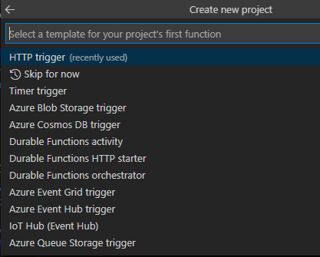
HTTP Trigger
Triggers the execution of your lines of code based on the HTTP Request.

Slide 17
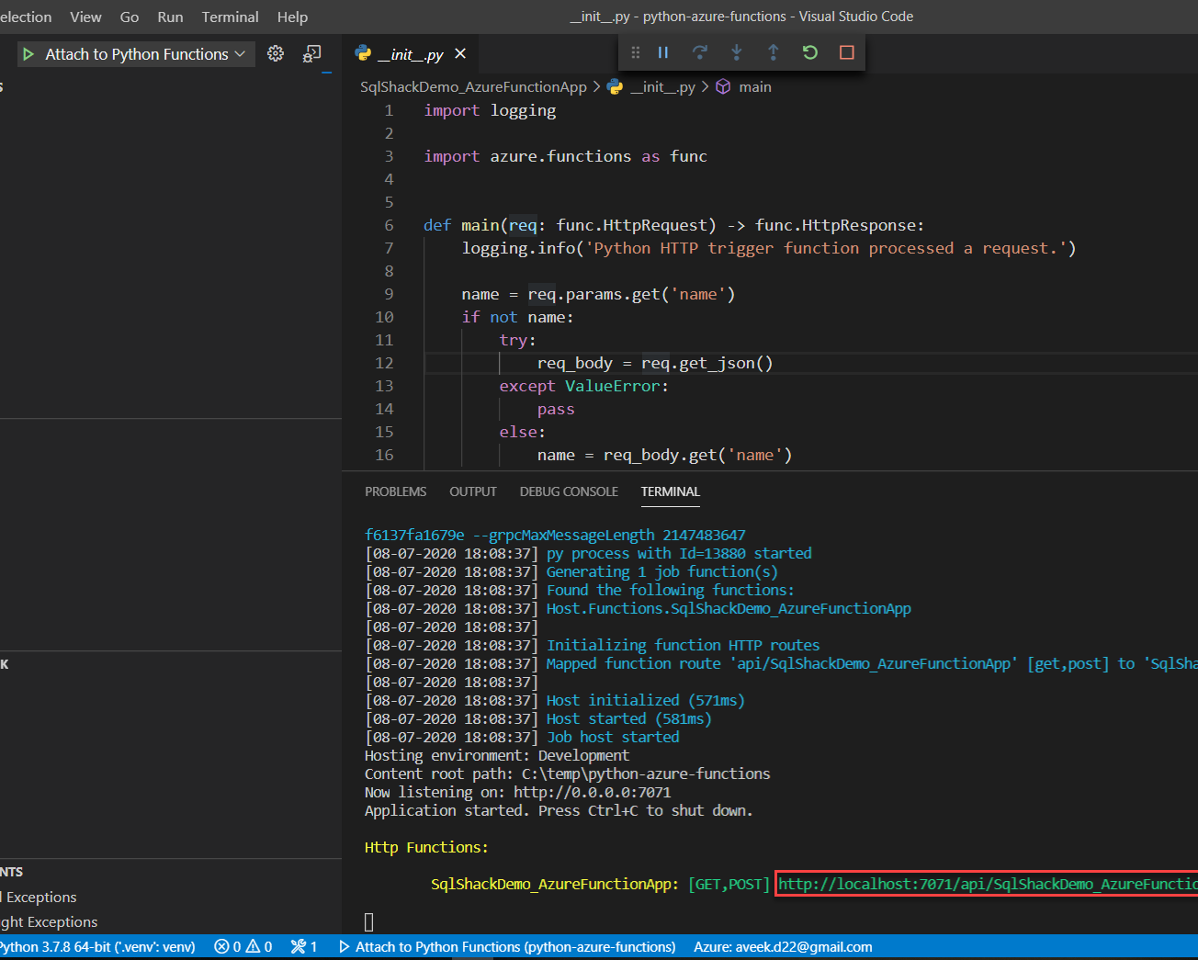
Timer Trigger
Triggers the execution of your code based on some Scheduled time.
The basic format of the CRON expressions in Azure is: {second} {minute} {hour} {day} {month} {day of the week} e.g. 0 * * * * * (=every minute)

Slide 18
Cosmosdb Trigger
Process Azure Cosmos DB documents when they are added or updated in collections in a NoSQL database.
Configure your environment.
Create your Azure Cosmos DB account.
Create an Azure Cosmos DB database and container.
Update your function app settings.
Register binding extensions.
Add an output binding.
Add code that uses the output binding.
Run the function locally.

Slide 19
Blob Trigger
The Blob storage trigger starts a function when a new or updated blob is detected. The blob contents are provided as input to the function.
The Azure Blob storage trigger requires a general-purpose storage account. Storage V2 accounts with hierarchical namespaces are also supported.

Slide 20
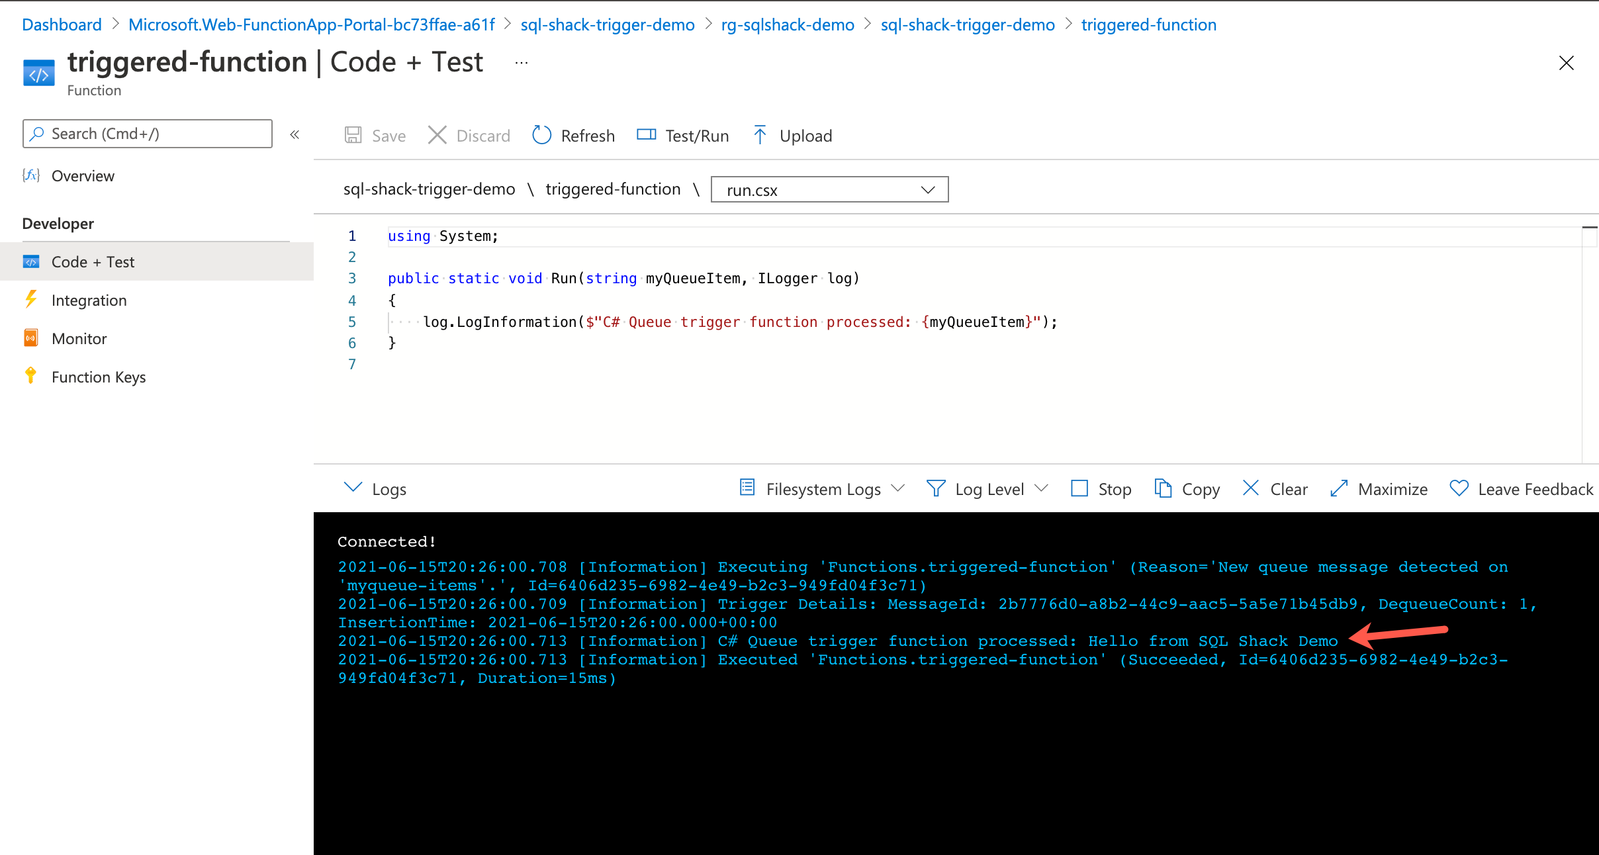
Queue Trigger
Respond to messages as they arrive in an Azure Storage queue.
Create Azure Function - Queue Trigger in Visual Studio
Log in here. ...
Open Visual Studio and choose to create a new Project.
Now, choose Azure Functions here.
Next, enter your Project name. ...
In the next window, Choose triggers as Timmer Trigger Function and Schedule for every 1 minute.

Slide 21
EventGrid Trigger
Functions provides an Event Grid trigger, which invokes a function when an event is received from Event Grid. A similar output binding can be used to send events from your function to an Event Grid custom topic. You can also use an HTTP trigger to handle Event Grid Events..

Slide 22
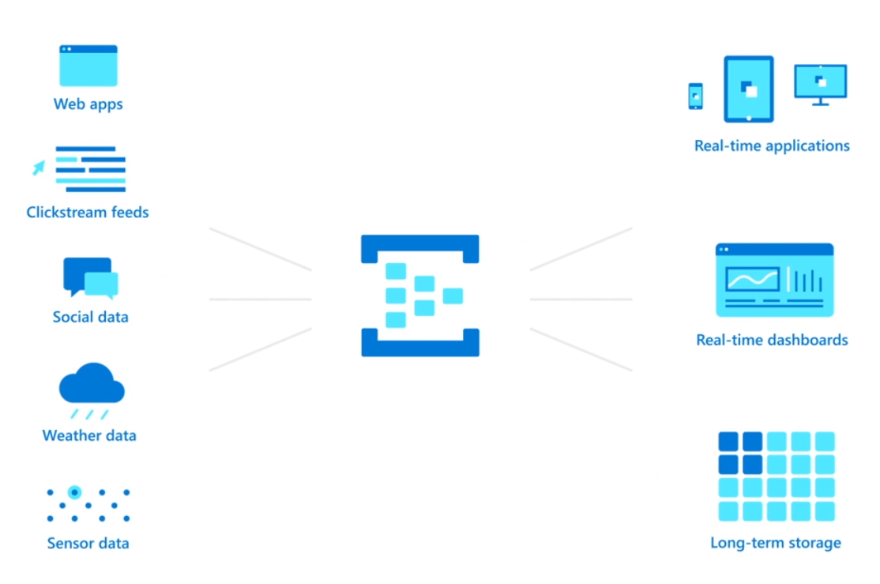
EventHub Trigger
Respond to events delivered to an Azure Event Hub. Particularly useful in application instrumentation, user experience or workflow processing, and internet-of-things (IoT) scenarios.

